Slide 1



Data Science @ Digital Advertising
Dr. Chong Zan Kai
zankai.chong@ada-asia.com
Machine Learning Engineer at Axiata Digital Advertising
LinkedIn: https://www.linkedin.com/in/zan-kai-chong/
Talk @ UTAR 18-Feb-2019
Notes:
Audience : UTAR data mining students.
Objective:
- Introduce the data science use case in digital advertising.
Expectation:
- Students will have a brief understanding of how data science is applied in digital advertising.
-

Slide 2
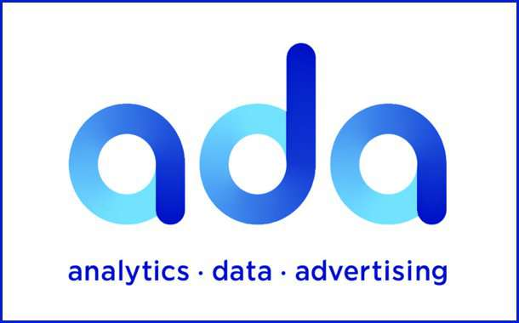

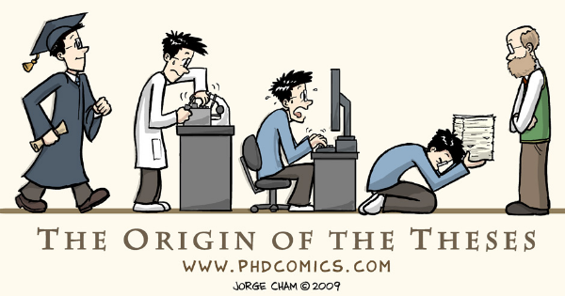
About Dr. Chong Zan Kai
Graduated from Electronic Engineering (majoring in Computer), MMU, 2006
Master in Engineering Science, MMU, 2010
PhD in Engineering Science, UTAR, 2016
Lecturer in LKC FES, UTAR for 7 years.
Joined Axiata Digita Advertising as machine learning engineer for 2 years.

Slide 3
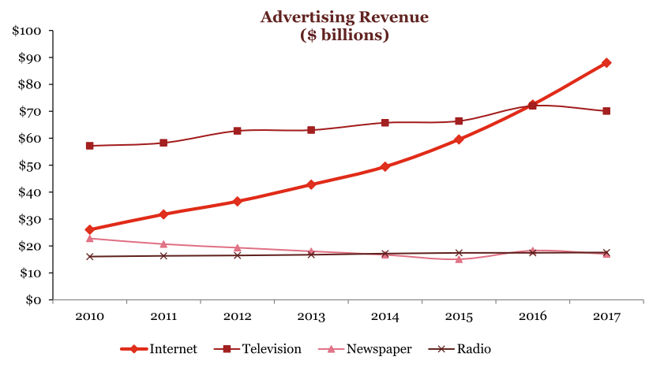
Some Facts: Internet advertising extends its lead and market share, while television growth slows (IAB internet advertising revenue report, 2017)

Slide 4

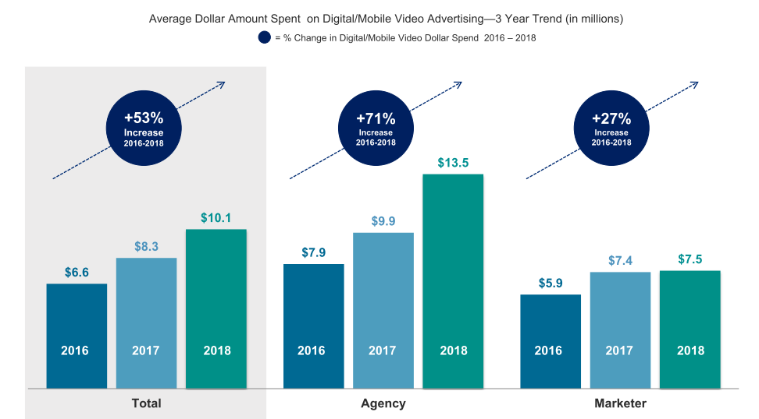
IAB 2018 Video Ad Spend Study

Slide 5
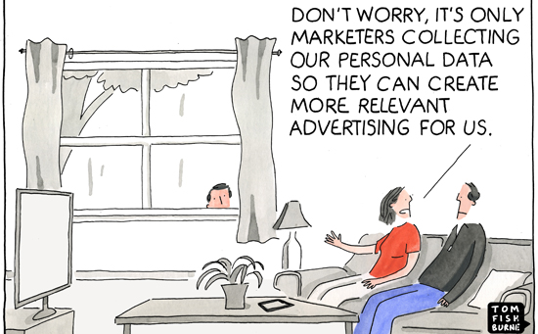
What is Digital Advertising?

Slide 6
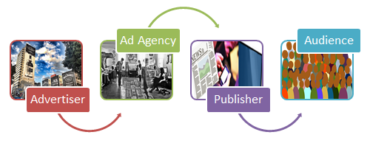
Traditional Advertising
https://www.omni-academy.com/course/digital-advertising-marketing/​
Notes:
Introduce the traditional advertising

Slide 7
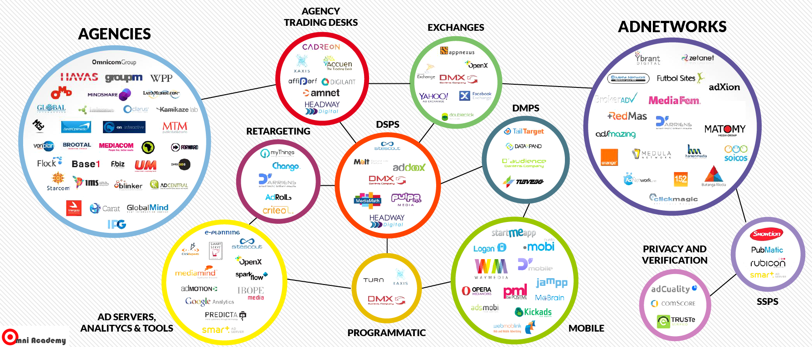
Digital Advertising Ecosystem
https://www.omni-academy.com/course/digital-advertising-marketing/
Notes:
The digital advertising - The actual map is much more complex.

Slide 8
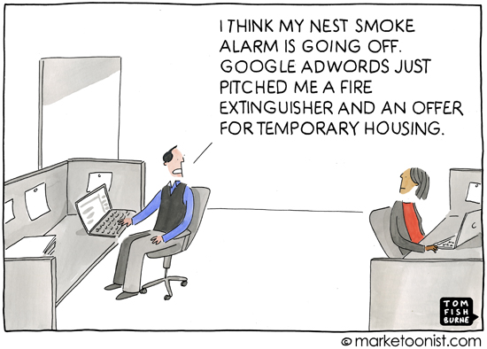

Slide 9
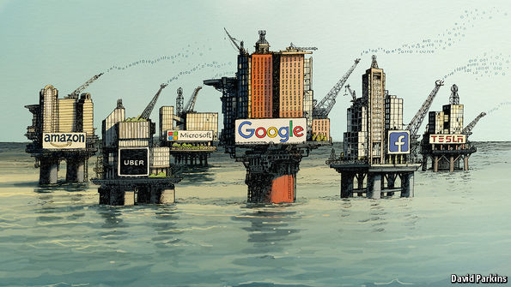
"Data is new oil"
Notes:
Data is important – that is why everyone is harvesting the data at the best effort.

Slide 10
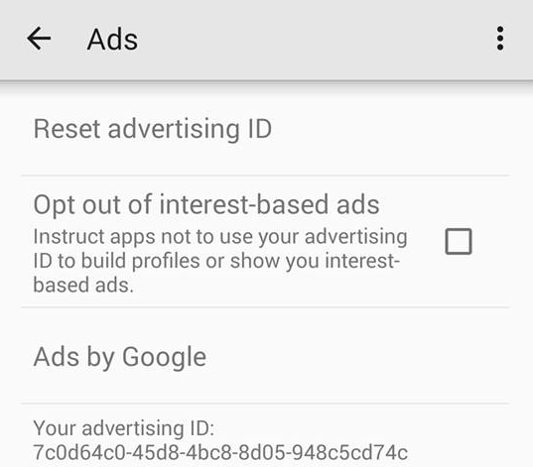
Android's Identity for Advertising (IFA)

Slide 11
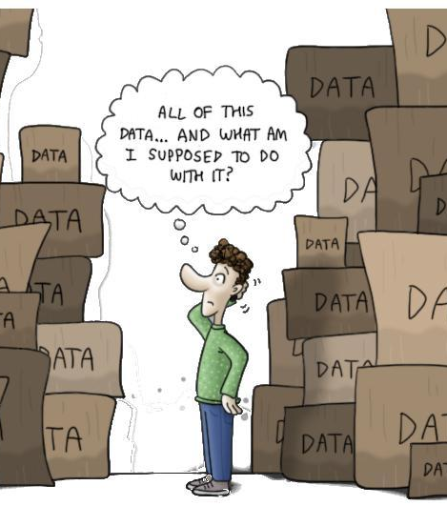
About the Data
First party data – clients' own collected data. Good quality with PII but normally in small scale.
Second party data – Buy from first party. Normally pre-processed.
Third party data – Collected by third party, normally in large scale and non-PII. Bad data quality.

Slide 12
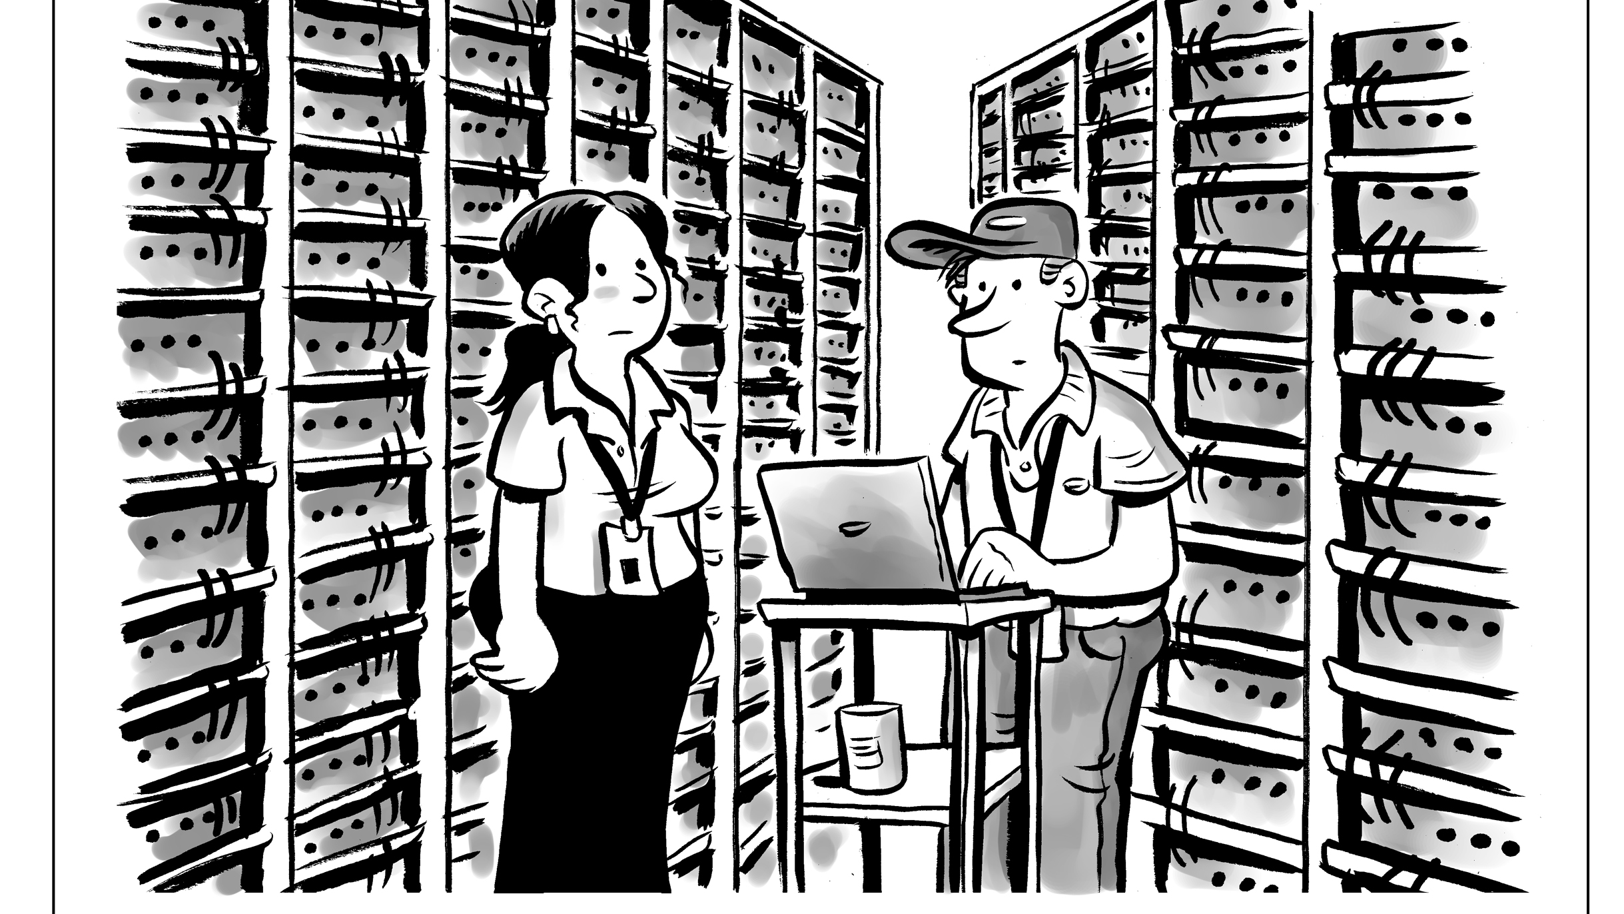
Data Sources @ ada
Facebook and Google partners
Android app usage behavior @ Ad Exchange Platform
Web surfing behaviour @ Data Broker
Telco

Slide 13
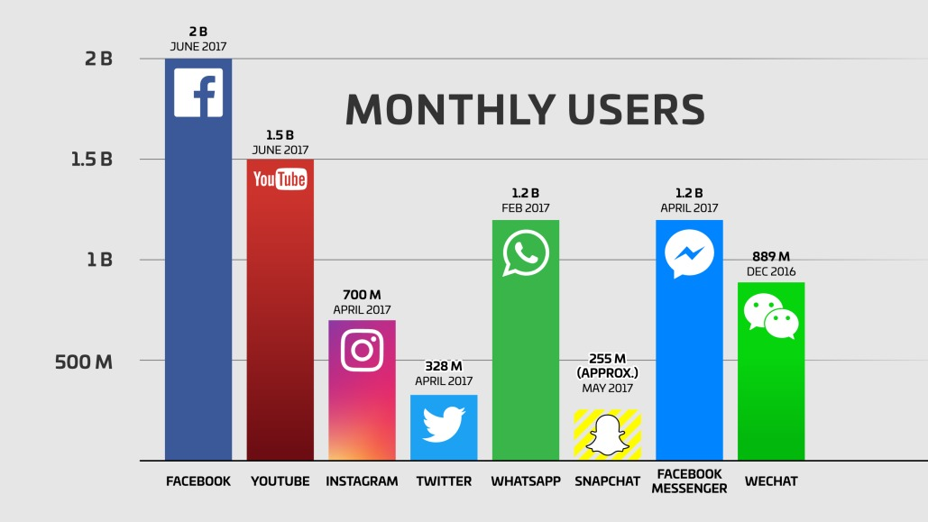
https://www.bigcommerce.com/blog/social-media-advertising/#1-facebook-advertising
Notes:
https://www.bigcommerce.com/blog/social-media-advertising/#1-facebook-advertising

Slide 14
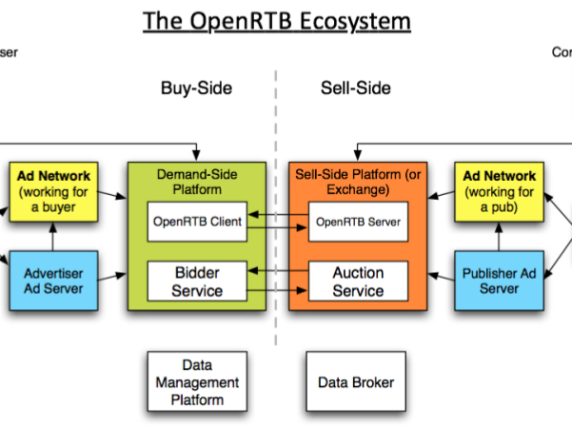

Data from Ad Exchange Platform

Slide 15
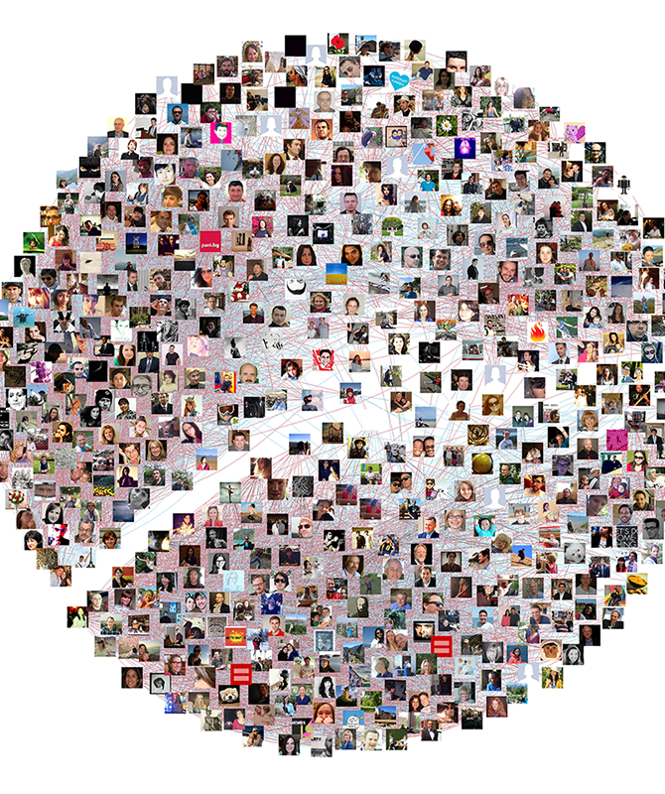


Web Tracking
IP, browser details are harversted
https://www.theguardian.com/commentisfree/2018/mar/28 (Web view)

Slide 16
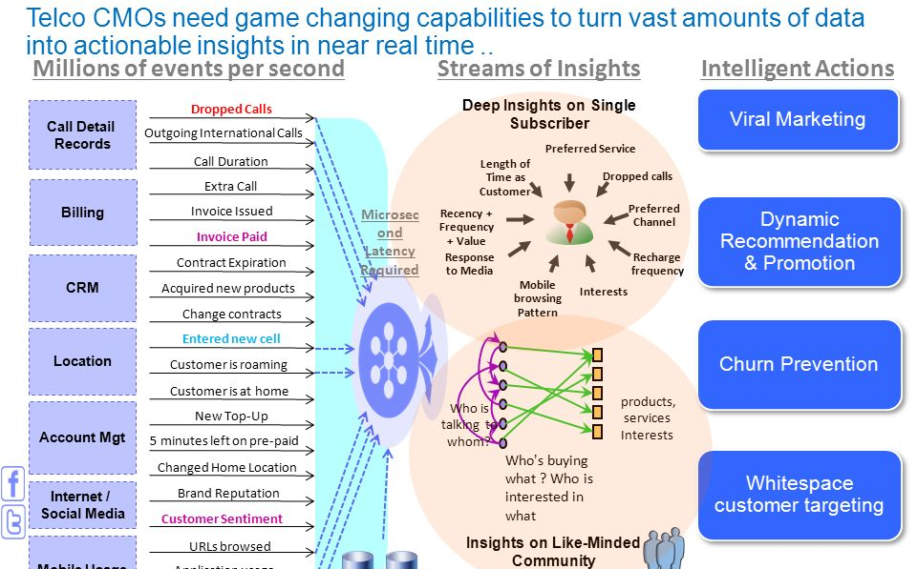
Telco Data

Slide 17
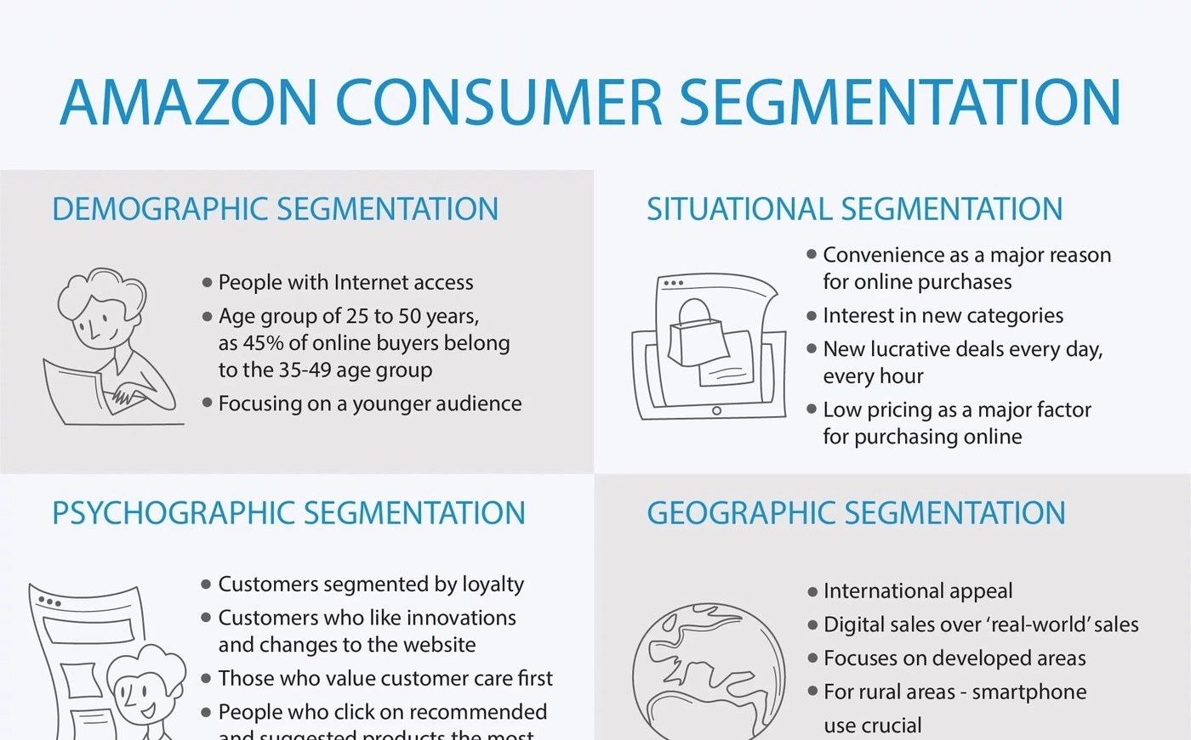
Use Case: Audience Segmentation FOR ad
Notes:
https://iotechnologies.com/blog/as-amazon?

Slide 18
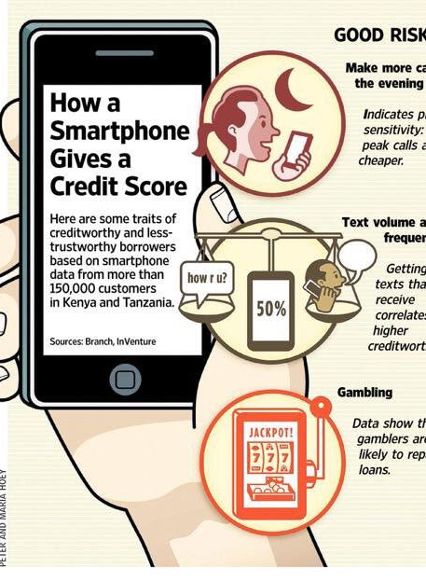
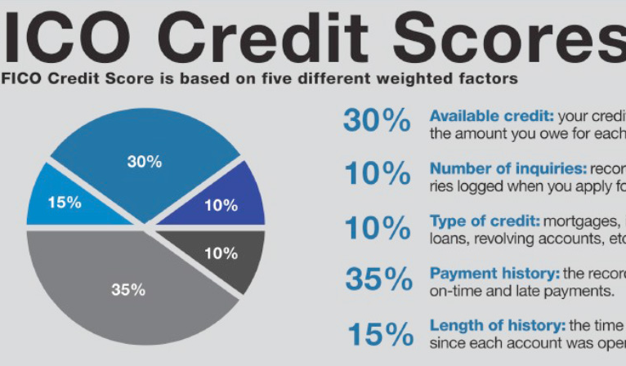
Use Case – Credit Scoring

Slide 19
Disclaimer
The opinions expressed in this presentation and on the following slides are solely those of the presenter. There is no guarantee the accuracy or reliability of the information provided herein.
Note that the creatives (graphics) are extracted from Internet and the presenter does not hold the copyright correspondingly.

Slide 20


